Slide 1



A New Innovative software model for Indian Railways MMIS Tech & Concepts welcomes
Shri. Jayant Singh - Programme Director
Concepts Conceived and developed by
Ravi Ganesh Mantha – CEO Suswa Infoway (P) Ltd.
Mentor – MMIS Technologies

Slide 2
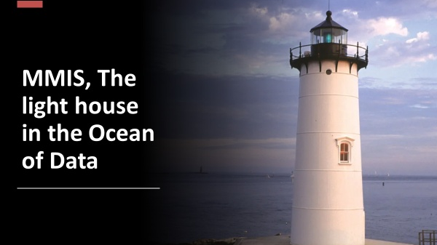
Our views
TEAM MMIS

Slide 3
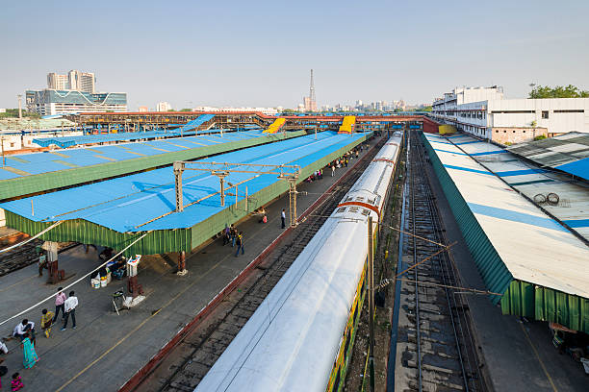

Introduction to MMISTech. & Concepts
True value @ Indian Railways.(IR)
In an increasingly complex IR MIS Systems, MMIS Tech is prepared for the challenges of today & tomorrow to address data visualizations and analytics in standard mode on go, to develop Dynamic & virtual IR Digital Safety System Maps. – Enabling Strategic Autonomy.
3

Slide 4
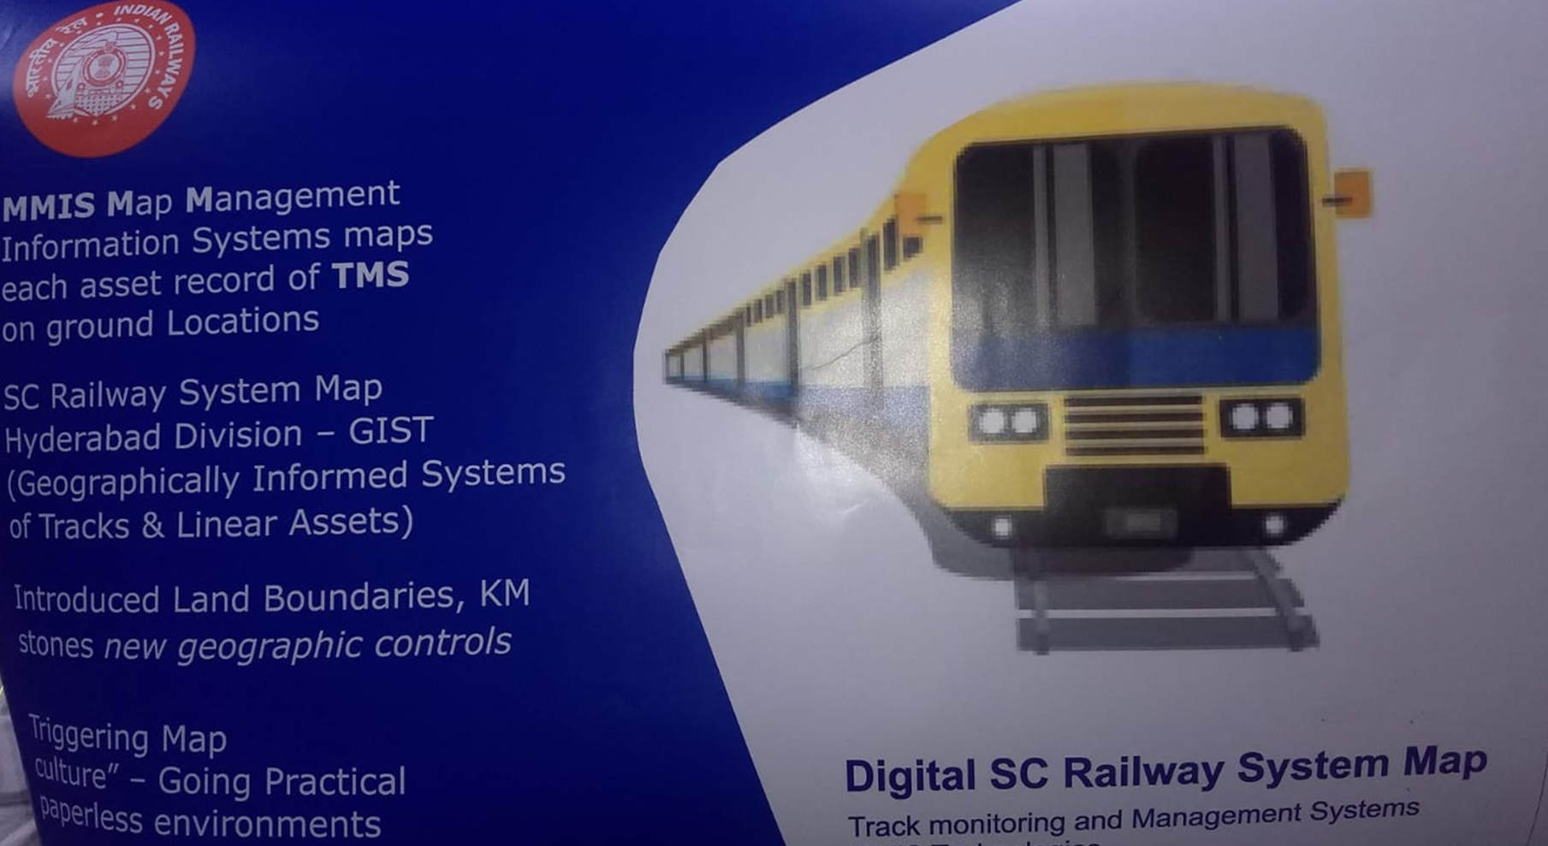
MMIS Models were presented @ IPWE 2018 Seminar Value of Maps in TMS Data SCR

Slide 5
Flow of the Presentation
Introduction to Tech. & Concepts and its Value through safety apps. @ IR.
Digital Safety Systems - IR Passengers/Personnel/Properties.
Features of IR GIST, The Digital safety.
Potential of IR GIST product on Safety when fully developed.
Application of DST @ Indian Railways – an overview.
Demonstration of IR-GIST.
Conclusions.

Slide 6
Introduction to MMIS Tech. & Concepts. Digital safety apps. Web & mobile @ IR.
Map is a “Superset form of The data and MIS is subset to Maps”.
Map Management Information Systems (MMIS) are unique and fuses Dynamic MIS of IR to Map frames for generation of “Dynamic and interactive IR System Map”.
“We recommend, if you have any complex problem (MIS front) look at the maps, they will provide solutions with strategic depth paving way for strategic autonomy.”
MMIS Tech. & Concepts are validated from Academia to Industry. “Rated as “A” Grade Technologoes by Xlr8AP/FICCI.

Slide 7
Digital Safety Systems The DST, for IR Passengers/Personnel/Properties.
The Digital Safety Tools are software driven, use researched techniques.
MMIS Tech ensure cent percent safety in defined mode such as:
  Buffer zone and alarm settings by users for their needful purposes, towards self safety on the move along Rail tracks any time round the clock.
  Usage of these DST tools are Demonstrated @ HYB and SC Divisions of SCR .
MMIS, strengthens safety systems of rolling stocks/locomotives, Rail Track and Linear assets for Scientific and Digital safety.
Our safety models shall attempt to provide Virtual models for flood monitoring when live IMD data integrations.
  Low level bridges early impact assessments from flood possibility.

Slide 8
MMIS Tech, strengthens safety systems of rolling stocks/locomotives, Rail Track and Linear assets for Scientific supervision and for Digital safety enhancements.
IR DSS map has a mechanism to pinpoint and generate at any poin of time.
    Virtual views of movements/health on real time basis of rolling stocks/locomotives, Rail Track and Linear Assets.
IR DSS application shall trace & track LAs through spatial IDs. on updated health status from TMS of each linear Assets.
IR DSS shall generate variation report on safety norms of thresholds values and variations thereof, at any point of time, (incase of variations).
IR DSS app-. Shall surface health of rolling stocks & what GMT left and carried on rail streaches/segments.

Slide 9
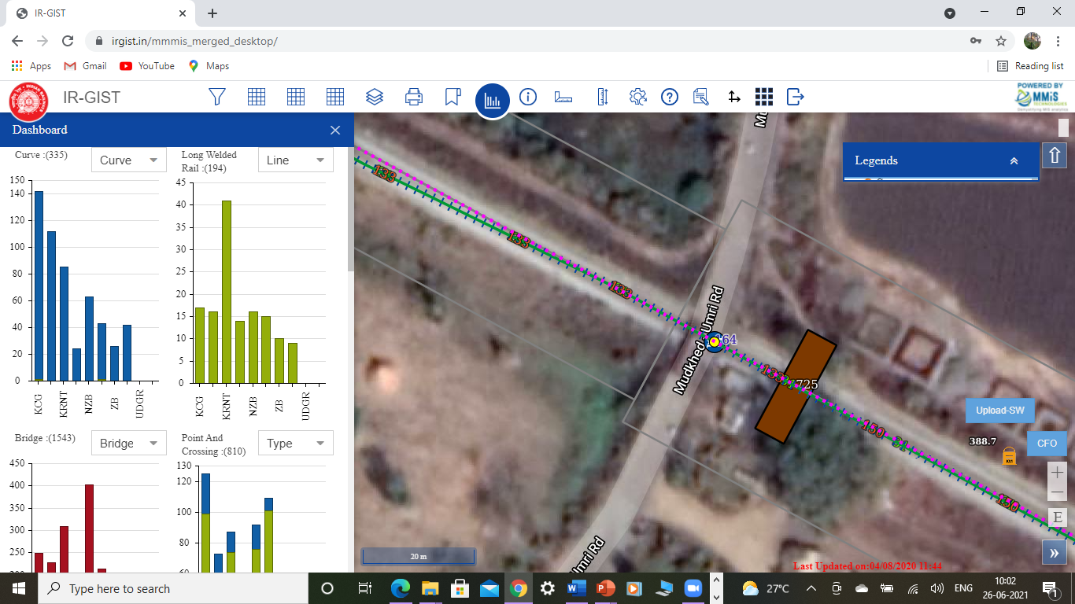
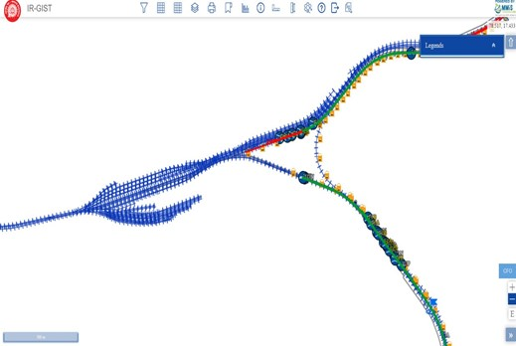
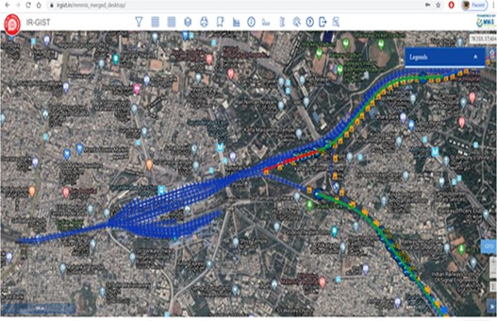
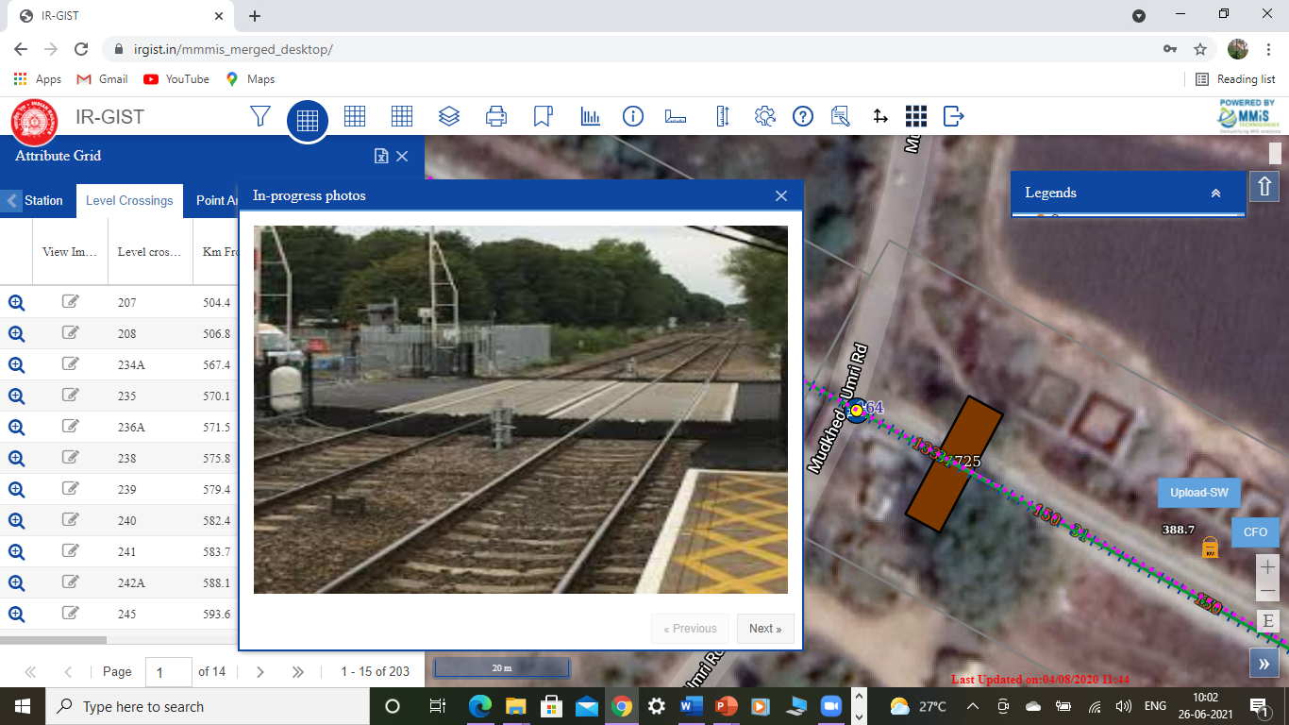
Digital tracks with Google overlay of Digital Base Map and with Google overlays (below)
Rail Section pictorial representation of
SSE jurisdictions Linear Assets with Google
With RYG intelligence and its snap (below)

Slide 10
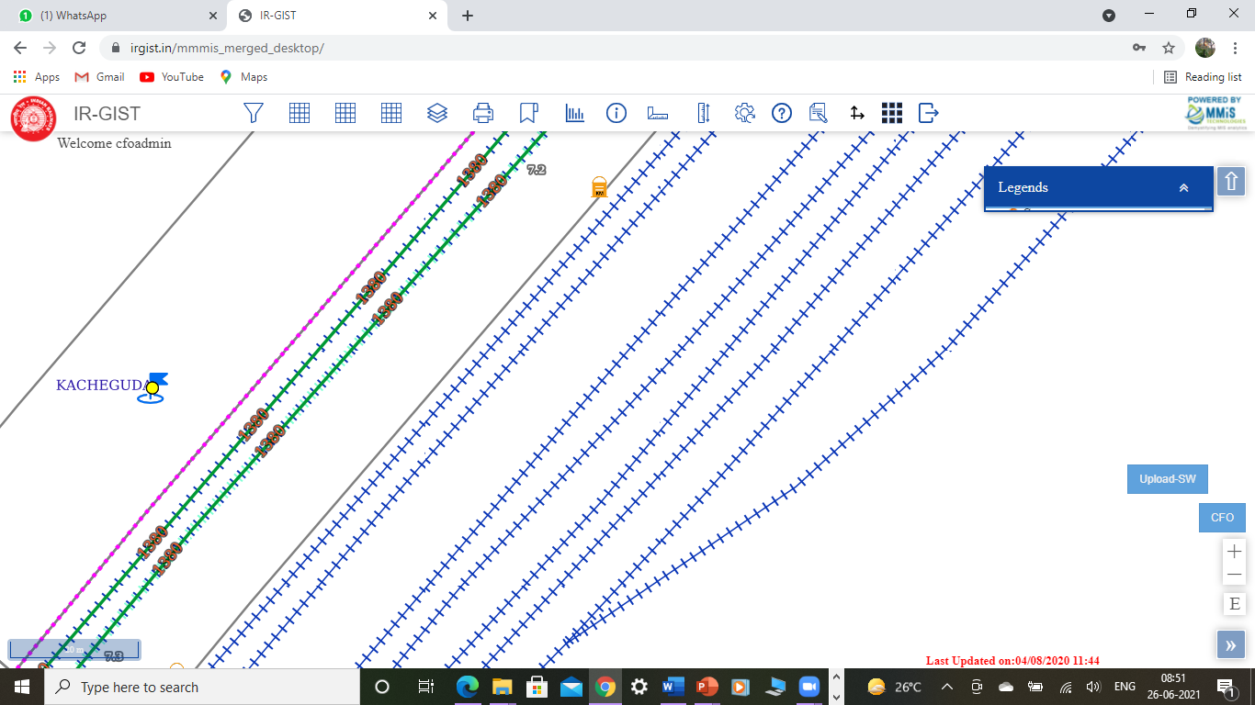
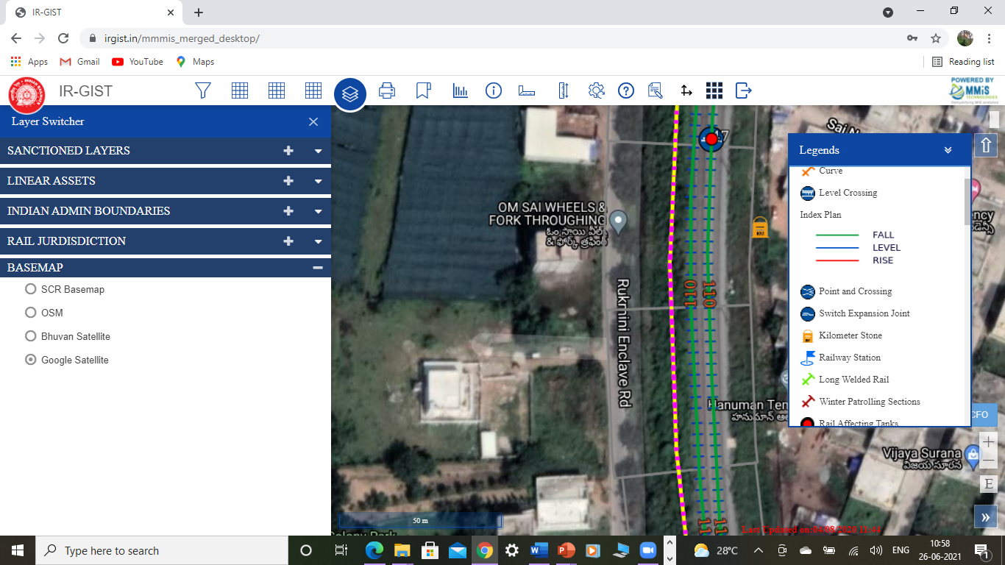
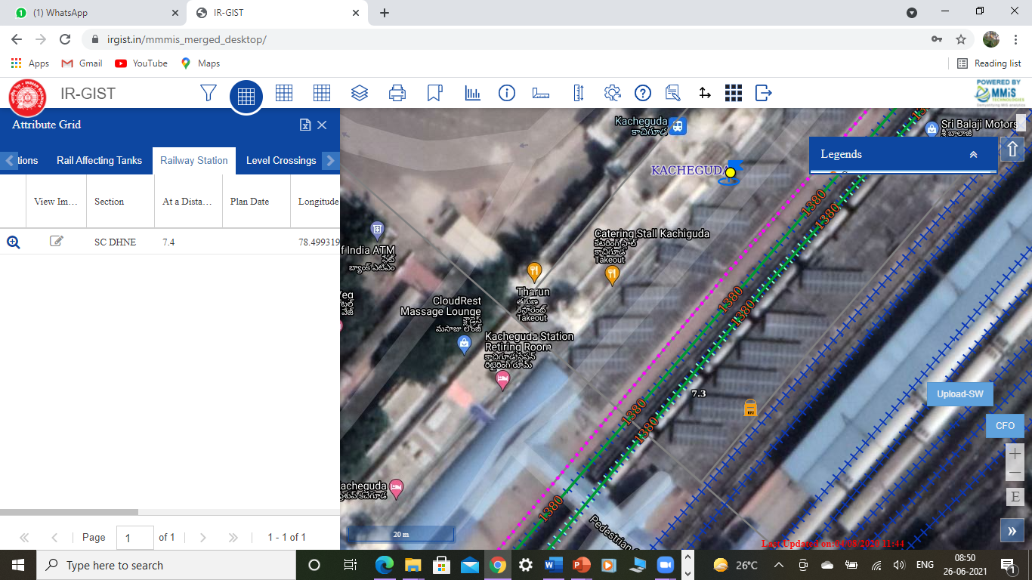
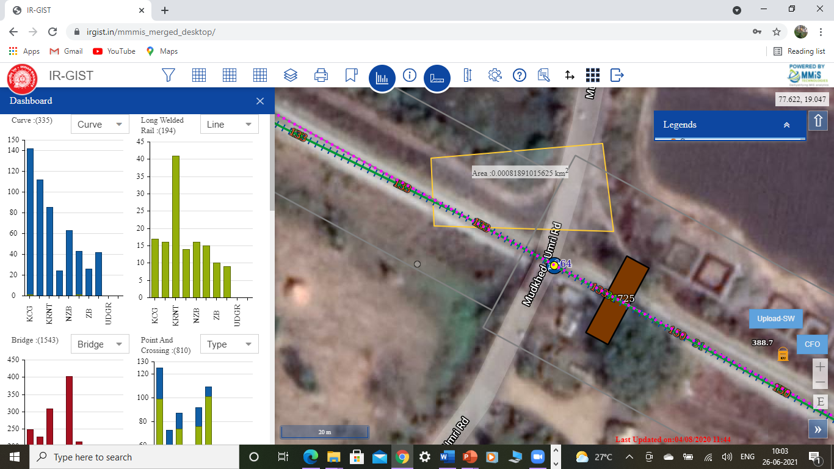
Railway station yard lines of Kachiguda station Digital tracks and Google overlay below
PSM Data overlaid of TRW works with Land boundaries and KM stone post (without survey) /Below Area/leaner measurement tools (below)

Slide 11
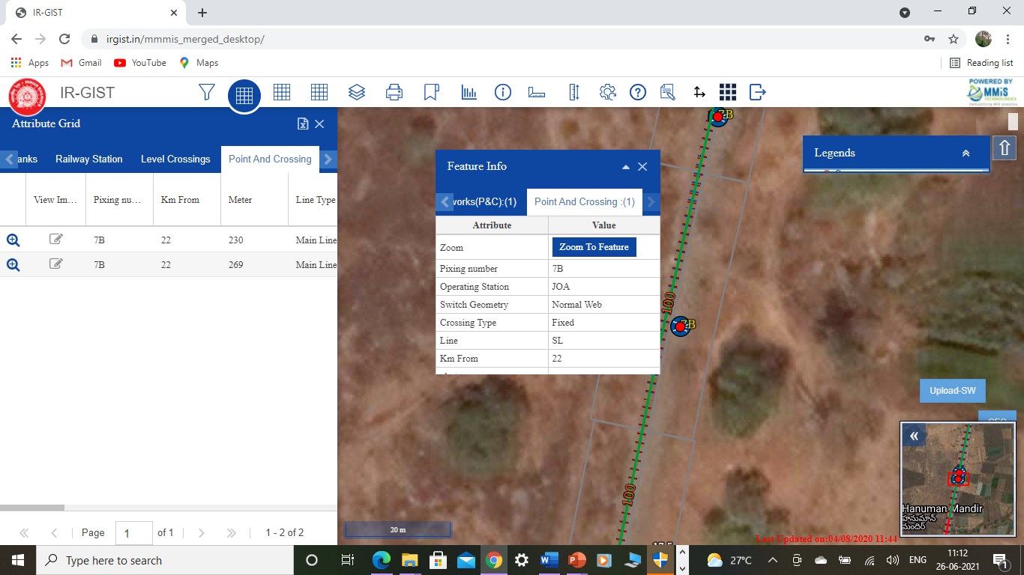
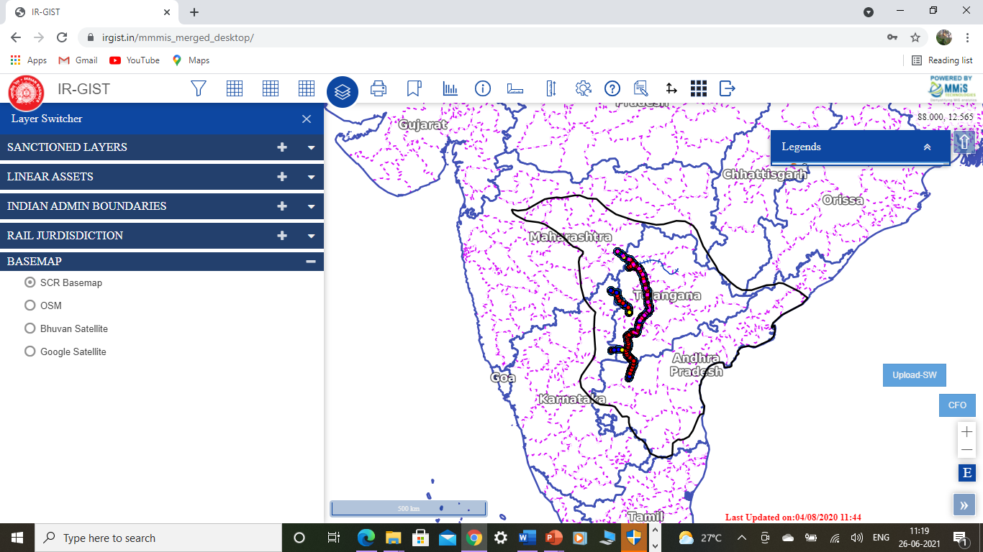
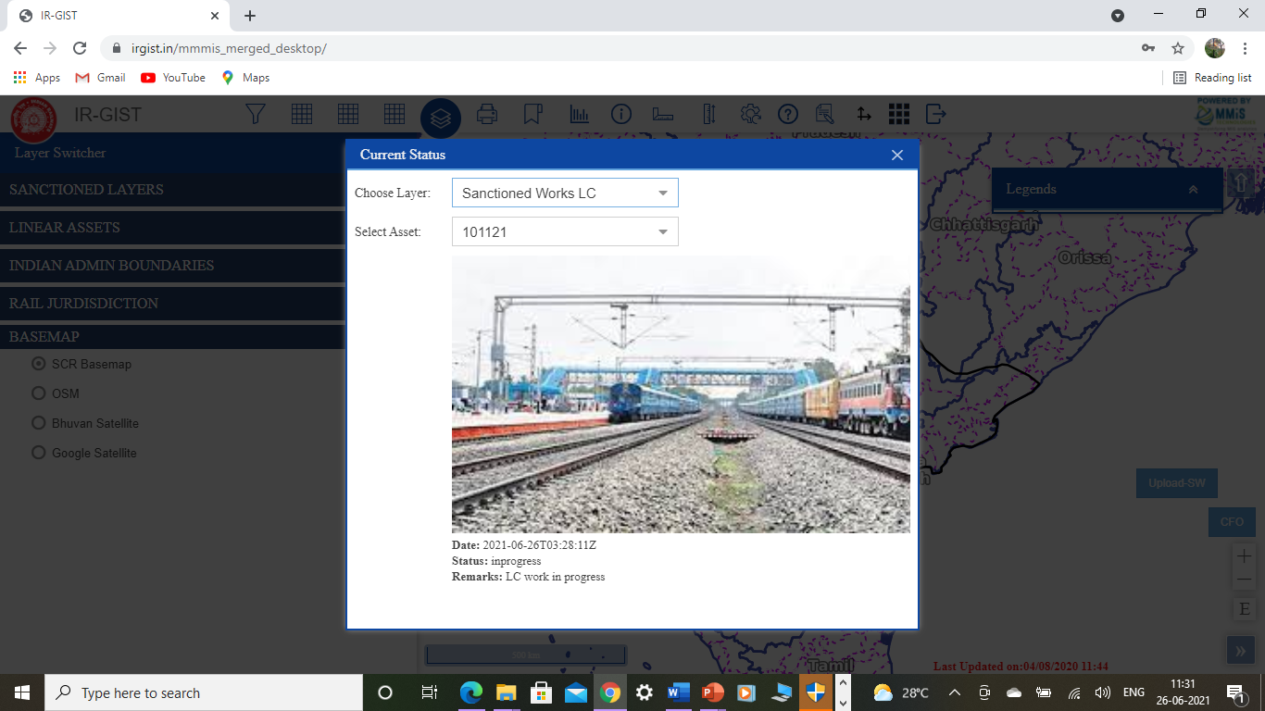
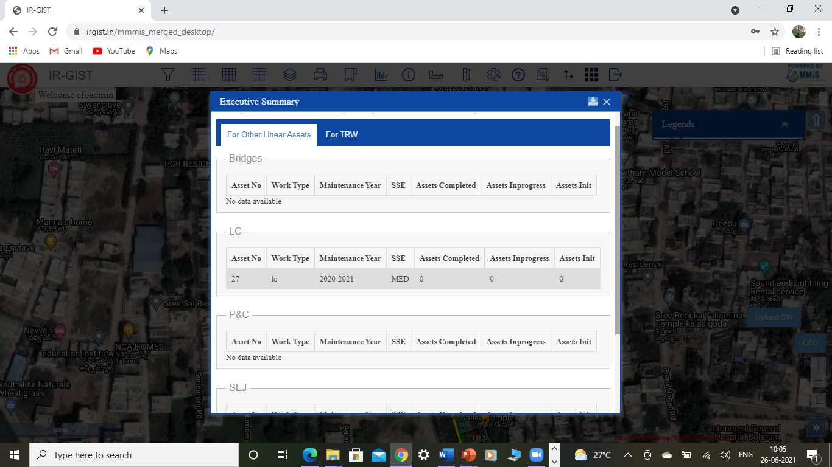
Linear Assets Points & Crossings with info tool at 20 meter high(1:500 scale)/ Executive summaries below from field dynamically
SC Railway Digital Map with std. admin. Boundaries and current status, works photos (below) – in IR GIST Frames

Slide 12
Potential of IR GIST product on Safety when fully developed – MMIS Tech.
IR GIST – Product can be extended to – Operating, Mechanical, S&T and Commercial departments as well. Enables better coordination among user departments.
Each Rolling stocks/locomotives and Trains can be given Unique IDs.
Can know movement of locos/rolling stocks at any point of time.
GMT consumed by 52/60 Kg rail segments on daily basis.
E-caution orders can help non- stoppage of trains of all forms, as the speed restriction chainages can be dynamically entered and communicated to loco pilots, Additional alarms of safety for PSR when it approaches and leaves the stretches) Two layers of safety alarms.
Monitoring unscheduled stoppages and many more when customized to the need of strategists from time to time.
IR GIST convert Historic data on the application as it moves on the same Linear Tracks.
Balasore/Kanchenjunga like emergencies communication to drivers from SMs and Cabin staff locations onto moving trains.
Two level alarms and Buzzers when approaching Outer signals to loco pilots.

Slide 13
Digital Railway system map for safety systems enhancements.
Additional safety layers for IR Personnel, Passengers, properties & Local fellow citizens (Mobile/Web Technologies). Progressive Geo fencing strategies (Evaluated and demonstrated).
Lat./Longs. of each linear assets shall be extracted. - Uber/Ola like navigations
E – Caution orders – communication between SMs & Loco pilots for cautioned speed movements. RYG Intelligence to monitor progress of schedules planned at all levels.
MMIS systems developed under systems, do minimize surveying cost very significantly. TMS chainage a base for corrections of LAs position to have Indian Railway System Map with best ground accuracies.
Digital Dairies for SSEs. GIS Tools, to draw, assign symbol for layers provided. Can store Historic data spatially.

Slide 14
Application of DST @ Indian Railways an overview.
DST of POC developed for HYB Division was encouraging.
Satisfied stakeholders and willingness to use in the division.
RTIS - Real Time Train Tracking Information Systems info integrations – is Simple, very cost effective and convenient.
Models and methodologies to trace, track and tackle train movements with Mobile & web technologies.
Can display train movements likely congestion status ahead on hourly basis at stations for traffic planning of trains by controllers.

Slide 15
Our interactions and software improvement while interacting with NITI Aayog
Interacted with Vice chairman/CEO offices since over 15 months.
IR DST tools were presented to Shri. Jyoti Sinha and other officers and seeking advices from time to time.
Suggested improvements and bottlenecks are taken care of and addressed in our latest web and Mobile apps. tested by our team (Proactive approach).
Enabeled six stake holder communication systems to avoid collusions aand derailments incidents like.
“Kavach” can be further layered with our IR DSS tools to provide a mechanical sagety systems along with software Kavach at Indian Railways. .
Request for One zone (SCR) to test full features contemplatd as a projrct/recommendation to explore @ SCR zone.

Slide 16
Conclusions
MMIS Tech. value creations to strategist communities.
The suitable for providing Digital safety for IR Personnel, Passengers, properties & Local fellow citizens.
Product/applications are objective, and goal driven.
Web and Mobile based systems converts MIS to intelligent and actionable models for scientific decision support systems.
Features enhance additional safety systems to the existing mechanical/manual models.
are proven and established, mentioned in Parliament as well.
MMIS systems are practical paperless solutions.
MMIS are in implementation since 2010.
Implemented for IR, MHRD, ITC, ISB, FEMA, IGNOU (Course), NFCL, etc.
MMIS Tech, were appreciated by CDM (College of Defense Management Secunderbad.
Outcome - value for Health monitoring – can prepare a Basemap for National HHs data to plot entire populus oof the country useful to monitor PMO office programs.

Slide 17


Conclusions
MMIS Indian Origin Product
Govt. of India – MHRD
Normalised Data views will pave way for
one stop strategic spot for scientific
Analytics and decisions extracted and
Derived from Base IR – TMS/BMS data
Thank you sir.
TEAM MMIS
Notes:
17

Slide 18
Thus,,
Thank you
TEAM MMIS

